Slide 1

Credit Card Fraud Bot
ANDREW MCKAY III
ARTURO GARCIDUENAS
ALISSA BOLLA

Slide 2



Executive Summary
COLLECT CUSTOMER FRAUD CLAIM INFORMATION TO BUILD PREDICTIONS USING MACHINE LEARNING
INTERACTIVE CHATBOT FOR CUSTOMER TO REPORT CREDIT CARD FRAUD
BANKING INSTITUTION CAN DETERMINE IF TRANSACTION IS GENUINE OR FRAUDULENT
DETERMINATION IS MADE ON HOW TO HANDLE CUSTOMER’S CARD & CLAIM

Slide 3


Concept
Utilize Amazon Lex and Lambda to create a chatbot for customers to communicate potential credit card fraud to their banking institution
Chatbot will record the date, amount and where the transaction took place
Additional information to be gathered
Were the preceding transactions in-person or online
Is the customer in possession of their credit card
Based on the information provided by the customer, the banking institution will use historical fraud information to predict future behaviors

Slide 4

Data Techniques
AWS Management Console
Amazon Lex
Lambda
Kaggle
Exploring past fraud transactions
Cleaning and categorizing data
Build the Neural Network
Visualize the data

Slide 5

Approach
Technologies used
AWS
Python
Breakdown of tasks
Andrew – data collection
Art – data cleaning
Alissa – chatbot

Slide 6

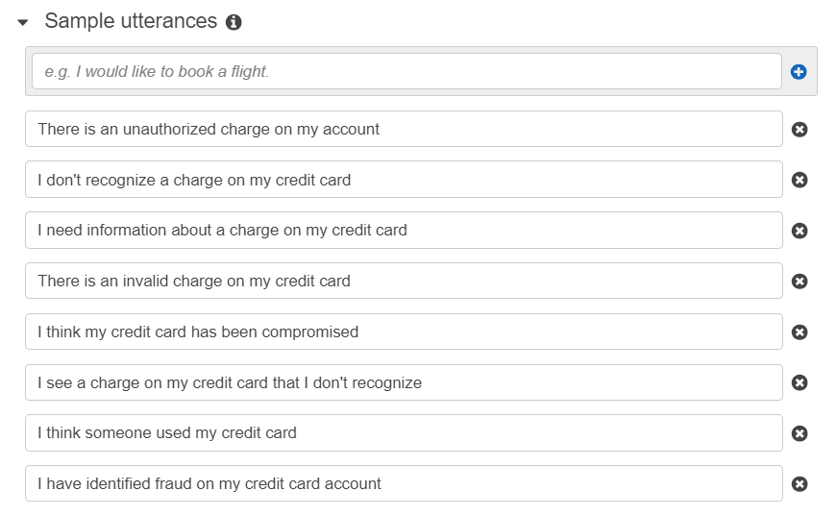
Credit Card Fraud Chatbot

Slide 7

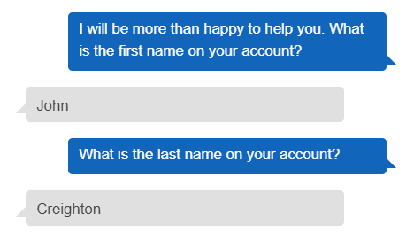
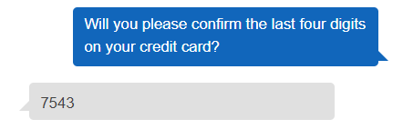
This is the customer’s initial interaction with the bot
The bot then verifies the customer’s first and last name
The bot verifies the customer’s card number in connection with their personal information

Slide 8
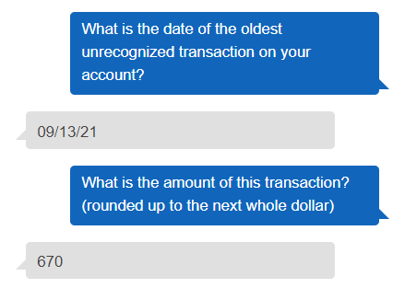
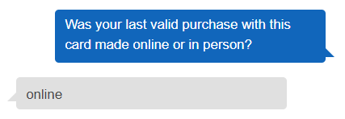
The bot collects details of the suspected fraudulent credit card charge
The type of purchase is recorded by the bot: in-person or online

Slide 9
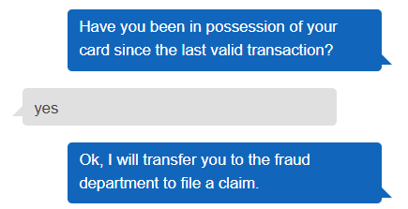
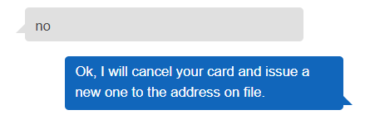
Confirmation Prompts
Based on the customer’s response, a claim is filed and/or a new card is issued

Slide 10
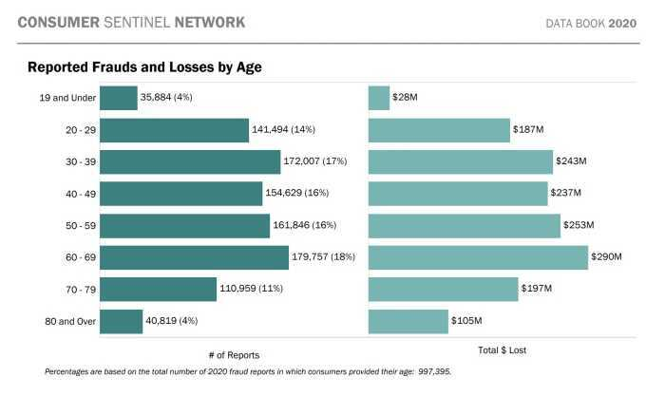
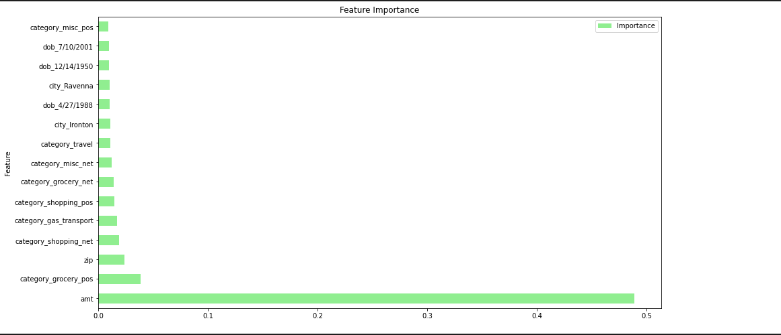
Credit Card Fraud
Instances of identity theft from credit card fraud increased by 45% in 2020 as compared to 2019
“Card Not Present” is tied to 65% of all losses to fraud
The top 3 states with identity theft by credit card are CA, FL, GA
People ages 30-39 reported the most cases of identity theft by credit card in 2020

Slide 11

Next Steps
Next Steps
Allow for the chatbot to create and develop actionable reporting to identify fraudulent transactions and minimize losses
Challenges
Technology - insufficient bandwidth to run code
Time frame necessary for the banking institution to collect enough information from the fraud chatbot to make actual future predictions and create customer alerts

Slide 12

Questions?

